Slide 1
Roadmap for leveraging Smart Buildings
A practical roadmap for achieving asset management goals through data-driven building solutions
Joep van der Weijden (TU Delft), Joppe Stelloo (Heijmans), Elena Chochanova (TNO)
This project received funding from the Dutch Ministry of Economic Affairs and Climate Policy and the Ministry of the Interior and Kingdom Relations under the MOOI program.

Slide 2
Joep van der Weijden
TU Delft
Joppe Stelloo
Heijmans
Elena Chochanova
TNO

Slide 3
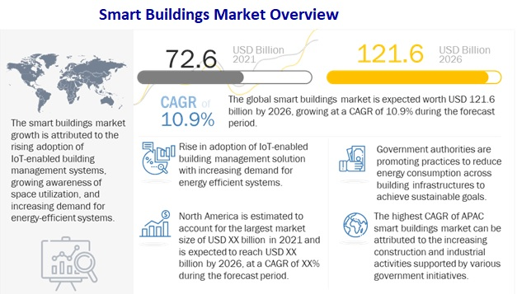
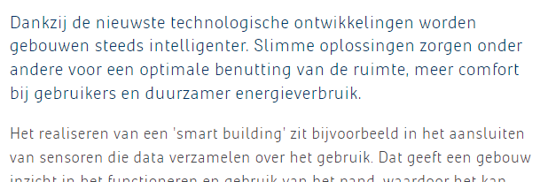
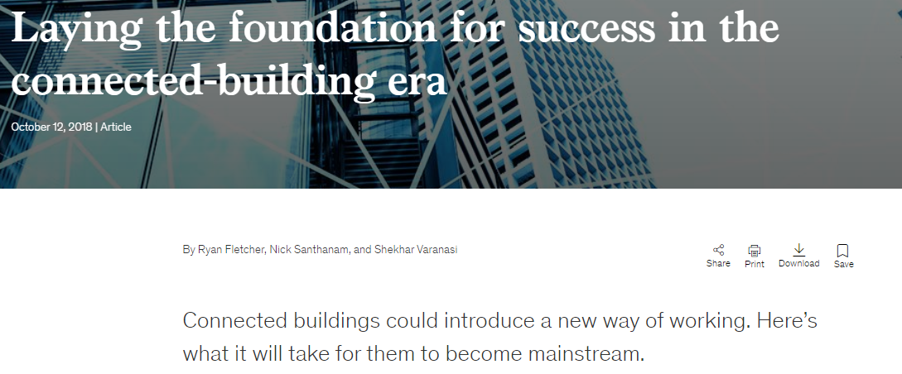
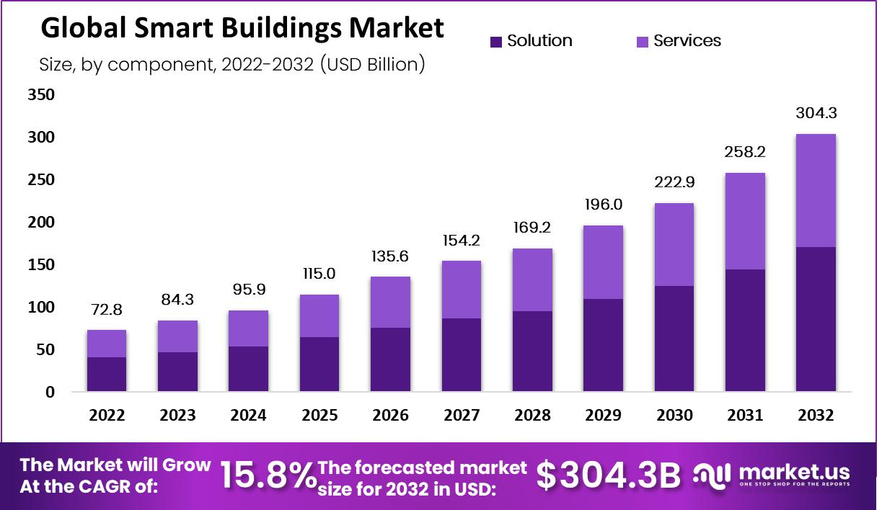
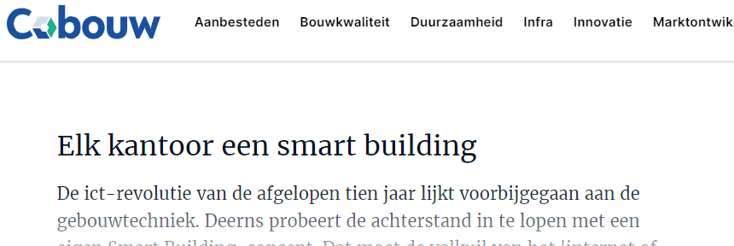
THE SMART BUILDING HYPE
70% (€900 billion last year) of the Smart Building Initiatives fail!
Digital Transformation Is Not About Technology
by Behnam Tabrizi, Ed Lam, Kirk Girard, and Vernon Irvin
Notes:
Update: met nieuwe comments.

Slide 4
“ 7 REASONS WHY YOU SHOULD NOT START WITH A SMART BUILDING„

Slide 5
Goal of this handbook
Create awareness about the current challenges in the industry and how they can be overcome with both high-tech and low-tech solutions;
Illustrate that a smart building is a tool and not a goal in itself to achieve a (set of) predefined asset management goal(s);
Provide the different stakeholders in the smart building value chain with a practical roadmap for achieving asset management goals through data-driven solutions, by starting with data integration.

Slide 6
Evaluate
Improve
Integrate
Assess asset’s current state
Evaluate effectiveness of BMS/EMS/LMS
Connect LMS/EMS to BMS
Define
data & system requirements
Define data gap
Start
Set AM goals & objectives
Data profiling, understand data sources
Perform data quality assessment
Improve operation of integration
Determine plan to fill the data gap
Design integration architecture; understand sources
Define asset data needs and requirements
Perform data quality assessment
Improve operation of existing systems
Data strategy implementation
Select integration tools and platforms
Define data gap
Pre-processing: Develop, test and deploy solution
No
Goals achievable?
Legend
Yes
Build application logic
Goals
Goals achieved?
No
Goals achieved?
No
Goals achieved?
No
Existing systems
Yes
Yes
Yes
New systems
End
Notes:
What, why, how beschreven per stap

Slide 7
Evaluate
Improve
Integrate
Assess asset’s current state
Evaluate effectiveness of BMS/EMS/LMS
Connect LMS/EMS to BMS
Define
data & system requirements
Define data gap
Start
Set AM goals & objectives
Data profiling, understand data sources
Perform data quality assessment
Improve operation of integration
Determine plan to fill the data gap
Design integration architecture; understand sources
Define asset data needs and requirements
Perform data quality assessment
Improve operation of existing systems
Data strategy implementation
Select integration tools and platforms
Define data gap
Pre-processing: Develop, test and deploy solution
No
Goals achievable?
Legend
Yes
Build application logic
Goals
Goals achieved?
No
Goals achieved?
No
Goals achieved?
No
Existing systems
Yes
Yes
Yes
New systems
End

Slide 8
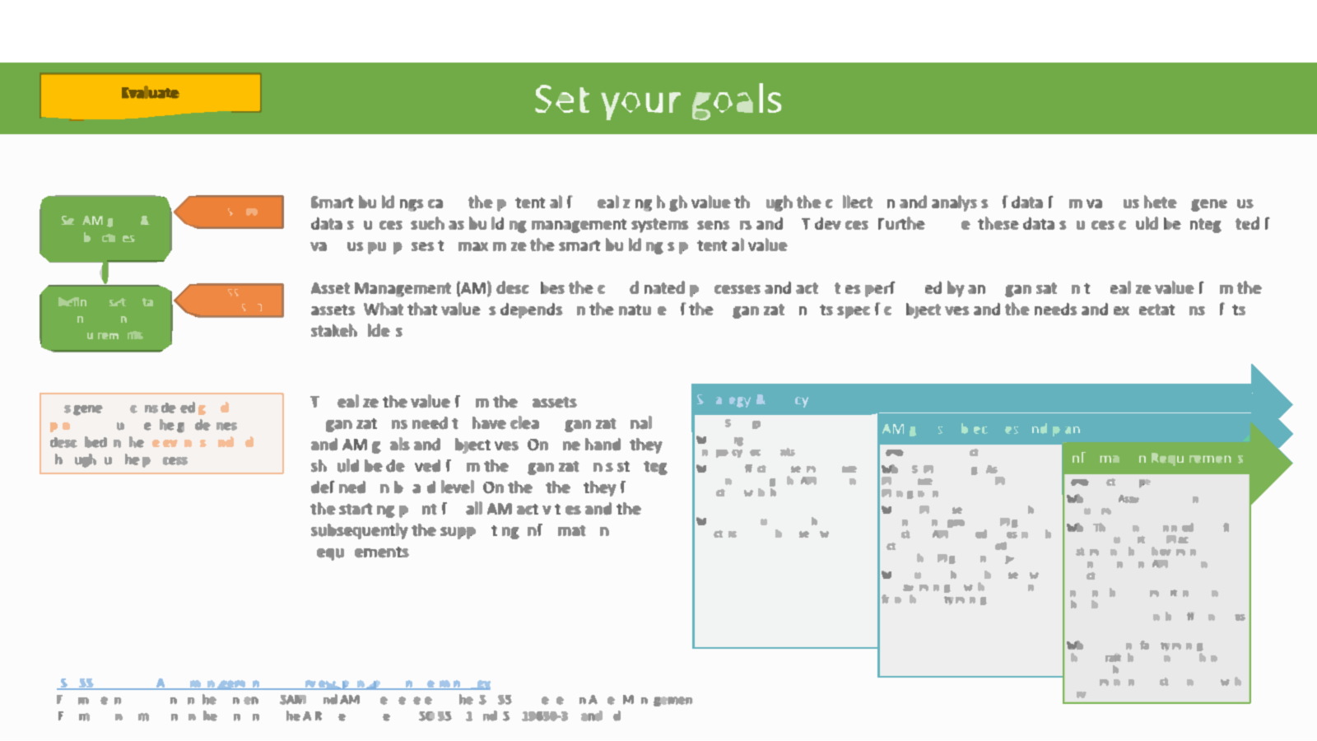
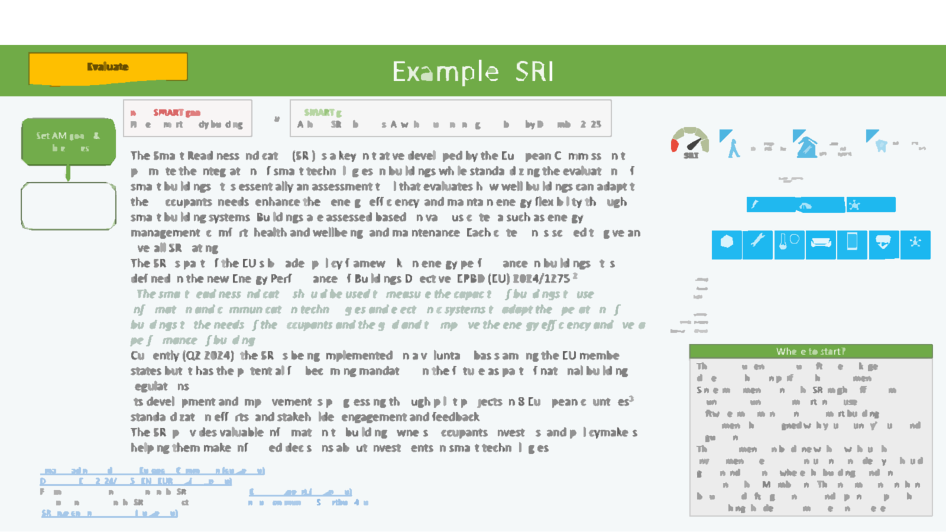
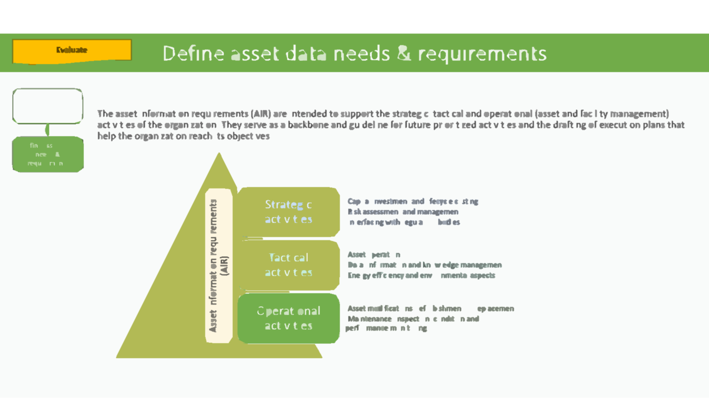
“Help the customer to define and prioritize her ambitions (goals & objectives)„
Strategy & Policy
What: Organizational strategic plans and policy documents
AM goals, objectives and plan
What: SAMP (Strategic Asset Management Plan) and AMP (Asset Management Plan)²
Information Requirements
Level: Tactic / Operational
What: AIR (Asset Information Requirements)³
Why: The organization needs to define its AIR to support its AM activities, systems and the achievement of its organizational and AM goals and objectives.
In doing that, it is important to ensure that there is consistency and traceability between the different types of data.
Who: Defined usually by the board of directors and/or the asset owner.
Why: For effective asset management it is essential to align the AM goals and objectives with the organization’s strategic plans.
Level: Strategic
Level: Strategic / Tactic
Who: Put together by the asset owner or asset manager, with possible input from the facility manager.
Why: SAMP is used to translate the organizational goals into AM goals and objectives. AMP is used to describe the activities and planning needed to realize the AM goals and objectives.
Who: Asset and facility managers should draft the AIR and use them to define exchange information requirement in projects/contracts with service providers.

Slide 9
“and translate those ambitions into clear asset data needs & requirements„
Asset information requirements (AIR)
Strategic activities
Capital investment and lifecycle costing
Asset modifications, refurbishment or replacement
Tactical activities
Operational activities
Asset operation
Interfacing with regulatory bodies
Maintenance, inspection, condition and performance monitoring
Data, information and knowledge management
Energy efficiency and environmental aspects
Risk assessment and management

Slide 10
Evaluate
Improve
Integrate
Assess asset’s current state
Evaluate effectiveness of BMS/EMS/LMS
Connect LMS/EMS to BMS
Define
data & system requirements
Define data gap
Start
Set AM goals & objectives
Data profiling, understand data sources
Perform data quality assessment
Improve operation of integration
Determine plan to fill the data gap
Design integration architecture; understand sources
Define asset data needs and requirements
Perform data quality assessment
Improve operation of existing systems
Data strategy implementation
Select integration tools and platforms
Define data gap
Pre-processing: Develop, test and deploy solution
No
Goals achievable?
Legend
Yes
Build application logic
Goals
Goals achieved?
No
Goals achieved?
No
Goals achieved?
No
Existing systems
Yes
Yes
Yes
New systems
End

Slide 11
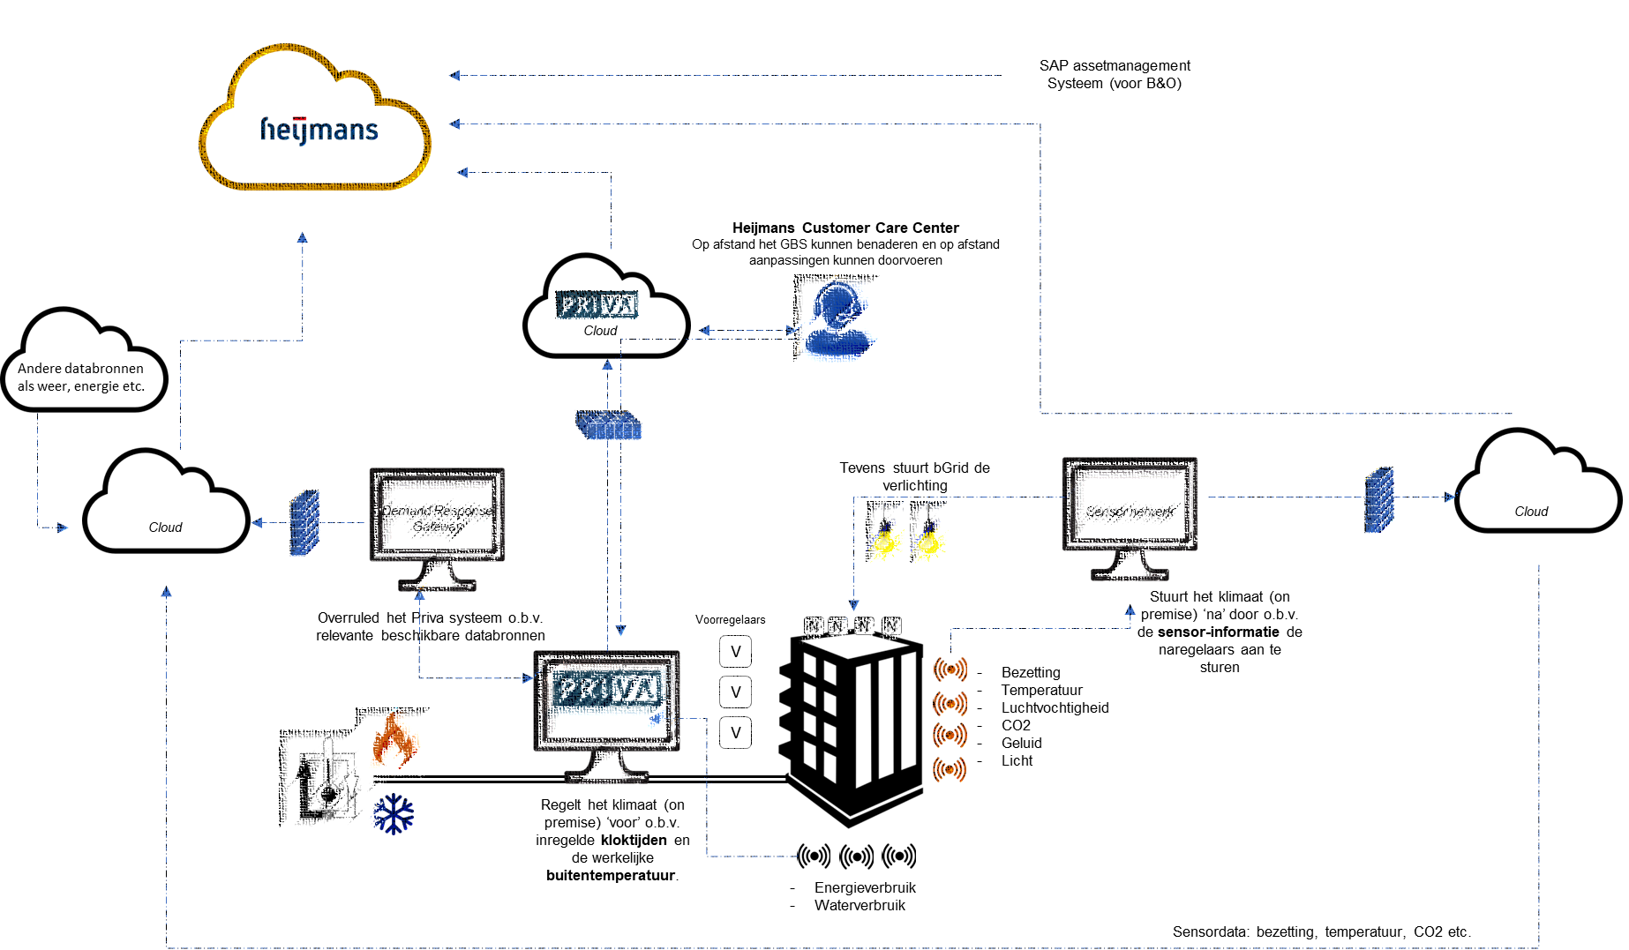
“Create a functional (IT/data) design
(as is & to be) and define data gaps„

Slide 12
“Evaluate (and optimize) the effectiveness of existing systems (BMS)”

Slide 13
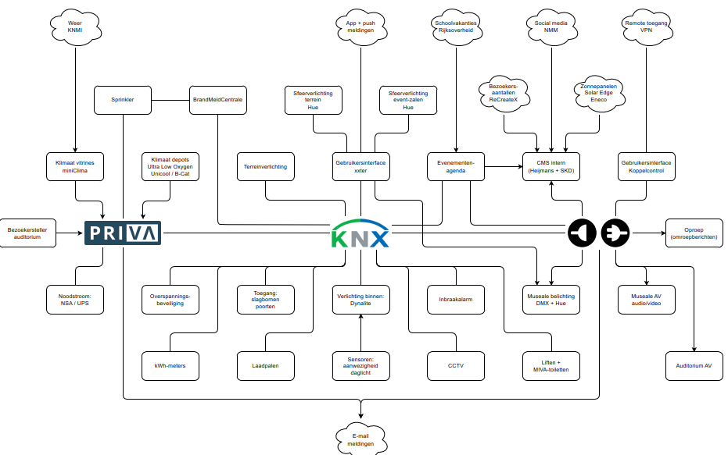
“Pick the low-hanging fruit”

Slide 14
Evaluate effectiveness of BMS/EMS/LMS
Improve
What does this step mean?
This step contains 3 sub-steps, but they all have the same purpose: optimizing the current management systems which are in place to make sure the building is operating properly.
Evaluate effectiveness: evaluate whether the current management systems are working as they supposed to
Perform an analysis to make sure the data quality is good enough
Improve the systems
Why do we need it?
In the Netherlands, 70% of comfort systems are not operating optimally¹. A significant reason for this is that the building management systems are not properly configured. This is logical because during the design of a building, specific occupancy and functions are assumed. However, these often change very quickly, resulting in the building not being tailored to the corresponding function and occupancy.
An analysis of many building management systems in existing buildings reveals that simply by optimizing the BMS (meaning solve the low-hanging fruit like optimizing the clock-times, optimize institutions) will result in an energy saving of approximately between 5% - 20%².
What are conditions and requirements for its execution?
The following steps are important for the execution:
Make sure the right skills are in place (to optimize a BMS you need specific skills; these are other skills than optimizing a Light management system).
Make sure the functionality of the building is clear. What are the opening times, what are the required performances of the building etc. This will be the input to optimize the management systems.
Who needs to do it?
The hard service provider or the BMS service provider can help you with this step. For specific items (lighting, energy) the specialist needs to be consulted.
Evaluate effectiveness of BMS/EMS/LMS
Connect LMS/EMS to BMS
Perform data quality assessment
Improve operation of integration
Improve operation of existing systems
Goals achieved?
No
Goals achieved?
Yes
Yes
¹ 70% van koelinstallaties werkt niet optimaal | (installatietotaal.nl)
² Energy Efficiency – Lawrence Berkeley National Laboratory (lbl.gov)

Slide 15
Connecting assets
Improve
What does this step mean?
A building has many stand-alone operating systems (burglary installation, light, energy etc.). Connecting these existing systems without ‘adding’ new systems to the building has shown to be a very interesting manner to optimize the building and realize the goal you have.
Why do we need it?
This step is important because it is a very (cost) effective way to optimize the performance of the building. And therefore, is it a very ‘smart and easy’ step by improving without bringing any new systems into the building.
What are conditions and requirements for its execution?
To execute this step, it is important to understand what assets you have and how/why you can combine them. This requires knowledge of the individual assets and what they can achieve combined. There are many specialists (hard service provider is one of them) who knows what combinations will create value.
Who needs to do it?
The hard service provider or the BMS service provider can help you with this step. For specific items (lighting, energy) the specialist needs to be consulted.
Evaluate effectiveness of BMS/EMS/LMS
Connect LMS/EMS to BMS
Perform data quality assessment
Improve operation of integration
Improve operation of existing systems
Goals achieved?
No
Goals achieved?
Yes
Yes

Slide 16
Evaluate
Improve
Integrate
Assess asset’s current state
Evaluate effectiveness of BMS/EMS/LMS
Connect LMS/EMS to BMS
Define
data & system requirements
Define data gap
Start
Set AM goals & objectives
Data profiling, understand data sources
Perform data quality assessment
Improve operation of integration
Determine plan to fill the data gap
Design integration architecture; understand sources
Define asset data needs and requirements
Perform data quality assessment
Improve operation of existing systems
Data strategy implementation
Select integration tools and platforms
Define data gap
Pre-processing: Develop, test and deploy solution
No
Goals achievable?
Legend
Yes
Build application logic
Goals
Goals achieved?
No
Goals achieved?
No
Goals achieved?
No
Existing systems
Yes
Yes
Yes
New systems
End

Slide 17
New systems
Integrate
Define
data & system requirements
Define data gap
Determine plan to fill the data gap
Design integration architecture; understand sources
Data strategy implementation
Select integration tools and platforms
Extend
Integrate
Pre-processing: Develop, test and deploy solution
Build application logic
Goals achieved?
No
Yes
End
Notes:
When the existing systems don’t suffice, extensions are necessary. This can be done with hardware and/or software. The flow diagram outlines the steps involved in a data strategy process, divided into two main stages: "Extend" and "Integrate.“
The following pages go through each of the steps on the right and describe what the steps entail, what the benefits are and what type of expertise might be required to perform the task.

Slide 18
Define data & system requirements
Integrate
Define
data & system requirements
Define data gap
What
Questions to ask:
Which type of sensors/actuators need to be installed?
Which communication protocol do these sensors use?
Which communication protocols are supported by my BMS?
What is the measurement frequency?
Why
System requirements and data requirements
Who
Product developers and consultants, building and facility managers
Determine plan to fill the data gap
Design integration architecture; understand sources
Data strategy implementation
Select integration tools and platforms
Pre-processing: Develop, test and deploy solution
Build application logic
Goals achieved?
No
Yes
End
Notes:
Examples:
- It is preferred to know the temperature and flow of the incoming air to the AHU while there is currently no flow sensor installed.
- There are no (digitally) controllable valves for the heating per room. The extension would be to install controllable valves on the heating installation.
When sensors are installed without looking at the existing systems in the building, it might not be possible to integrate the new sensors. E.g. if the sensors communicate using Modbus, but the existing BMS only supports M-bus, there will be difficulty with the implementation. This is a system requirement.
Additionally, if a measurement frequency of one second is required, but the sensor can only measure once every minute, the data requirements are not met.

Slide 19
Install additional monitoring
Integrate
Define
data & system requirements
Define data gap
What
Questions which need to be answered:
Where do we install these sensors and control valves?
What is the prioritization of the identified installations?
What are the costs involved with filling these gaps?
Why
budget and time constraints.
Who
Building- and facility managers, installers.
Determine plan to fill the data gap
Design integration architecture; understand sources
Data strategy implementation
Select integration tools and platforms
Pre-processing: Develop, test and deploy solution
Build application logic
Goals achieved?
No
Yes
End

Slide 20
Install additional monitoring
Integrate
Define
data & system requirements
Define data gap
Determine plan to fill the data gap
Design integration architecture; understand sources
Data strategy implementation
Select integration tools and platforms
Pre-processing: Develop, test and deploy solution
Build application logic
Goals achieved?
No
Yes
End

Slide 21
Data integration
Integrate
Define
data & system requirements
Define data gap
Determine plan to fill the data gap
Design integration architecture; understand sources
Operational and contextual data from various sources and systems:
time series data
contextual building data (linked data)
Lack of interoperability
Data strategy implementation
Select integration tools and platforms
Pre-processing: Develop, test and deploy solution
Build application logic
Goals achieved?
No
Yes
End
Notes:
time series data provide operational information for HVAC systems, lighting, alarms, energy meters, weather services, smart devices, etc.
contextual building data (linked data) includes Building Information Models (BIM), technical drawings, Process and Instrumentation Diagrams (P&ID), product databases, etc., which contain information about the configurations and relationships between different systems and their components.
There is little interaction between these islands of data due to their heterogeneity
They rely on different modelling approaches, languages and protocols
e.g., there is no straightforward way to integrate a Honeywell BMS system with a BIM model created on Autodesk Revit
Lack of interoperability hinders the research and development of smart building applications. The ability to integrate systems from multiple vendors is a major requirement to understand the energy usage, maintenance, and overall performance of buildings.
Therefore, it is necessary to setup a data infrastructure which allows for more extensive data interactions. These steps are described on the following pages.

Slide 22
Define data gap
Integrate
Define
data & system requirements
Define data gap
What does this step mean?
In this step, it is required to think about the asset management goals and how data/information can be used to achieve these goals.
Why do we need it?
Without taking the time to think about the remaining gaps, there is no end goal to work towards while integrating different types of data.
Who needs to do it?
Building- and facility managers, installers
Determine plan to fill the data gap
Design integration architecture; understand sources
Data strategy implementation
Select integration tools and platforms
Pre-processing: Develop, test and deploy solution
Build application logic
Goals achieved?
No
Yes
End

Slide 23
Integration architecture
Integrate
Define
data & system requirements
Define data gap
What does this step mean?
Smart buildings need to rely on a well-defined system architecture and Application Programming Interfaces (APIs) that enable both the integration of diverse systems and datasets and the orchestration of various services.
Choose an appropriate integration architecture (e.g., centralized, decentralized, hybrid) based on the scale and complexity of the BMS.
Design data flow diagrams to visualize the movement and transformation of data across systems.
Why do we need it?
Each individual building is unique, and path dependency plays a role, so developing a ‘one size fits all’ system architecture is impossible.
Who needs to do it?
Data(base) engineer, building and facility managers
Determine plan to fill the data gap
Design integration architecture; understand sources
Data strategy implementation
Select integration tools and platforms
Pre-processing: Develop, test and deploy solution
Build application logic
Goals achieved?
No
Yes
End

Slide 24
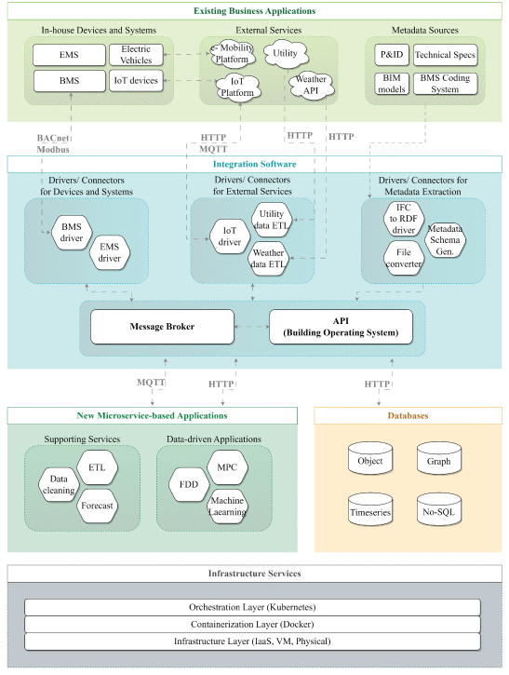
Reference architecture
The choice of a message broker, time series database, drivers and metadata database should be guided by the specific requirements of the BMS in terms of scalability, performance, data types, and operational environment.
It is also important to consider how these components integrate with each other to create a cohesive data integration ecosystem.
Source: L. Chamari, E. Petrova and P. Pauwels, "An End-to-End Implementation of a Service-Oriented Architecture for Data-Driven Smart Buildings," in IEEE Access, vol. 11, pp. 117261-117281, 2023, doi: 10.1109/ACCESS.2023.3325767
Notes:
The needed building blocks are dependent on the availability and required level of integration. E.g., if there are no IoT devices in the building which rely on Zigbee network with MQTT data sharing, then there is no need for an IoT Driver with MQTT.

Slide 25
Message broker
Integrate
What
A message broker acts as an intermediary for messaging between different systems or software components.
Why
It enables asynchronous communication, ensuring that messages are queued, delivered, and received reliably.
Conditions and requirements
Scalability
Performance
Reliability
Protocol Support
Integration Capabilities
Security
Who needs to do it?
Data engineer
Examples: RabbitMQ, Apache Kafka, MQTT brokers.
Define
data & system requirements
Define data gap
Determine plan to fill the data gap
Design integration architecture; understand sources
Data strategy implementation
Select integration tools and platforms
Pre-processing: Develop, test and deploy solution
Build application logic
Goals achieved?
No
Yes
End

Slide 26
Timeseries database
Integrate
What
A time series database is optimized for handling time-stamped or time-series data, such as sensor readings or log data, which is common in BMS.
Why
The previously mentioned message brokers get expensive when the datasets get larger over time. A timeseries database is ideal for storing information for longer periods of time.
What are conditions and requirements for its execution?
Write and Query Performance
Data Compression and Storage Efficiency
Scalability
Data Retention Policies
Integration with Analytics Tools
Reliability and High Availability
Who needs to do it?
Database engineer
Examples: InfluxDB, TimescaleDB, Prometheus.
Define
data & system requirements
Define data gap
Determine plan to fill the data gap
Design integration architecture; understand sources
Data strategy implementation
Select integration tools and platforms
Pre-processing: Develop, test and deploy solution
Build application logic
Goals achieved?
No
Yes
End

Slide 27
Driver
Integrate
What does this step mean?
A driver in data engineering serves as an intermediary that translates queries and data operations between the application and the data source, ensuring seamless data access and manipulation.
Why do we need it?
Interoperability
Abstraction
Efficiency
Standardization
Scalability
What are conditions and requirements for its execution?
Compatibility
Network Accessibility
Resource Availability
Who needs to do it?
Data engineer
Examples: MySQL ODBC Driver, PostgreSQL JDBC Driver, Apache Kafka Connectors
Define
data & system requirements
Define data gap
Determine plan to fill the data gap
Design integration architecture; understand sources
Data strategy implementation
Select integration tools and platforms
Pre-processing: Develop, test and deploy solution
Build application logic
Goals achieved?
No
Yes
End

Slide 28
Metadata database
Integrate
What
A metadata database stores information about other data in the system, such as data source details, schema information, building drawings, and configuration settings.
Why
While a timeseries database is ideal for storing time-stamped data, they are not suited for storing unstructured information. A metadata database is optimized for storing relational information.
Conditions and requirements
Schema Flexibility
Query Performance
Scalability
Consistency and Reliability
Interoperability
Security
Who needs to do it?
Database engineer
Examples: PostgreSQL (with JSONB support), MongoDB, Apache Cassandra.
Define
data & system requirements
Define data gap
Determine plan to fill the data gap
Design integration architecture; understand sources
Data strategy implementation
Select integration tools and platforms
Pre-processing: Develop, test and deploy solution
Build application logic
Goals achieved?
No
Yes
End

Slide 29
Pre-processing
Integrate
Define
data & system requirements
Define data gap
What
Before pushing the data to the message broker and database, the data needs to be clean.
Why
Oftentimes, data is not extracted in the required form. The labels are not intuitive, there is missing data, or the measurements are wrong (outliers).
Who
Data engineer with a building- and/or facility manager.
To dive deeper into the preprocessing, see course by Martin WP5
Determine plan to fill the data gap
Design integration architecture; understand sources
Data strategy implementation
Select integration tools and platforms
Pre-processing: Develop, test and deploy solution
Build application logic
Goals achieved?
No
Yes
End

Slide 30
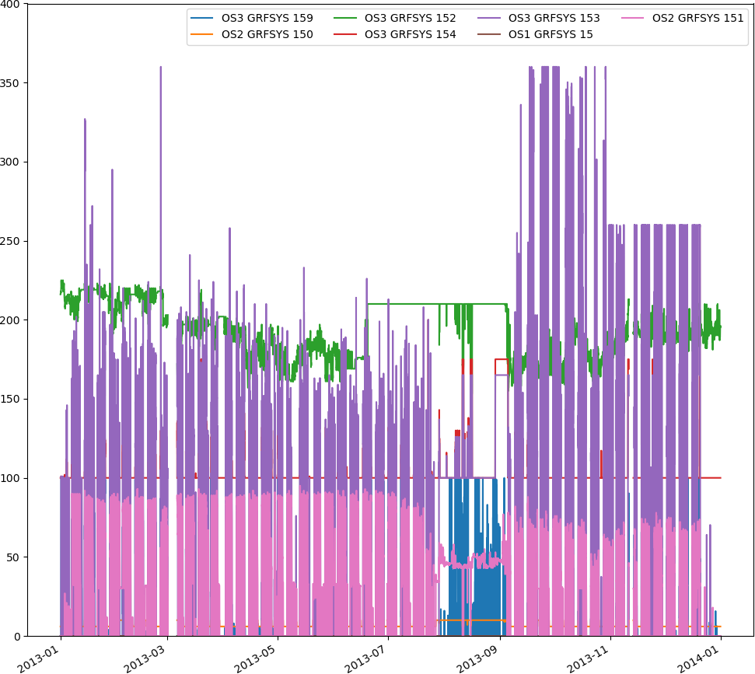
Units?
Data labelling
Labels?
One of the most common problems in smart building applications is inconsistent data labeling.
different vendors and follow different naming conventions.
Different buildings and systems use diverging standards and conventions.
Unstructured naming conventions and tagging systems to represent data syntax and semantics make it difficult to understand and interpret the data.

Slide 31
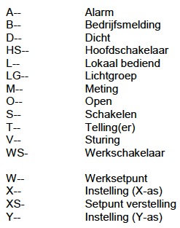
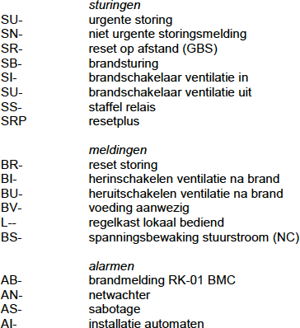
Name
Description
Data labelling
(28) 201.TA-01A--
Vorstgevaar
Building number: Building 28
System number: 201 = AHU
Control engineering code: CV = Control valve
(28) 302.VA-01A--
Afzuigventilator storing
(28) 201.VT-01A--
Toevoerventilator storing
(28) 201.CP-01A--
Circulatiepomp verwarmer storing
(28) 201.WW-01A--
Warmtewiel storing
(28) 201.VA-01A--
Afvoerventilator storing
(28) 201.CV-02V--
Regelafsluiter koeler
(28) 201.CV-01V--
Regelafsluiter verwarmer
(28) 201.VT-01B--
Toevoerventilator bedrijf
Example of naming convention in Johnson Controls
TU Delft sensor naming convention
(##) ###.XX-##XX-
(##) – Building number
### – System number
XX – Control engineering code
XX- – Reporting, measuring and control code
(28) 302.FT-01M--
Flowmeting LBK2
Process number
(28) 302.PT-01M--
Afzuigdrukopnemer
(28) 201.TT-02M--
Retourtemperatuur
(28) 201.PT-01M--
Inblaasdrukopnemer
Reporting, measuring and control code:
M--: measurement
(28) 201.TT-01M--
Inblaastemperatuur
(28) 201.PT-01M--
Afzuigdrukopnemer
(28) 201.MT-01M--
Inblaasvocht
(28) 302.VA-01B--
Afzuigventilator bedrijf
(28) 201.CD-02SW-
Afblaasluchtklep west vrijg.
(28) 201.CD-02SO-
Afblaasluchtklep oost vrijg.
(28) 302.VA-01S--
Afzuigventilato vrijgave
(28) 201.VT-01S--
Toevoerventilator vrijgave
(28) 201.CP-01S--
Circulatiepomp verwarmer vrijg.
(28) 201.WW-01S--
Warmtewiel vrijgave
(28) 201.VA-01S--
Afvoerventilator vrijgave
(28) 201.CP-01B--
Circulatiepomp verwarmer bedrijf
(28) 201.WW-01B--
Warmtewiel bedrijf
(28) 201.VA-01B--
Afvoerventilator bedrijf
(28) 201.WW-01V--
Warmtewiel sturing
(28) 302.VA-01V--
Afzuigventilator sturing
(28) 201.VT-01V--
Toevoervent. sturing
(28) 201.VA-01V--
Afvoervent. sturing
(28) 201.SC-03M--
Signaal toerenreg. VA
(28) 201.SC-02M--
Signaal toerenreg. VA
(28) 201.SC-01M--
Signaal toerenreg. VT
(28) 201.TT-03M--
Aanzuigtemperatuur
(28) 201.TT-07M--
Retourtemp. verwarmer
(28) 201.TT-05M--
Inblaastemp. na ww
(28) 201.TT-04M--
Afblaastemp. na ww
(28) 201.PDT03M--
Drukverschil 1e filter
(28) 201.PDT04M--
Drukverschil 2e filter
(28) 302.CD-01V--
Luchtklep sturing

Slide 32
Missing data
Techniques used for treating erroneous and missing values vary from one application to another:
replacing with next or previous value
Interpolation
Rolling average

Slide 33
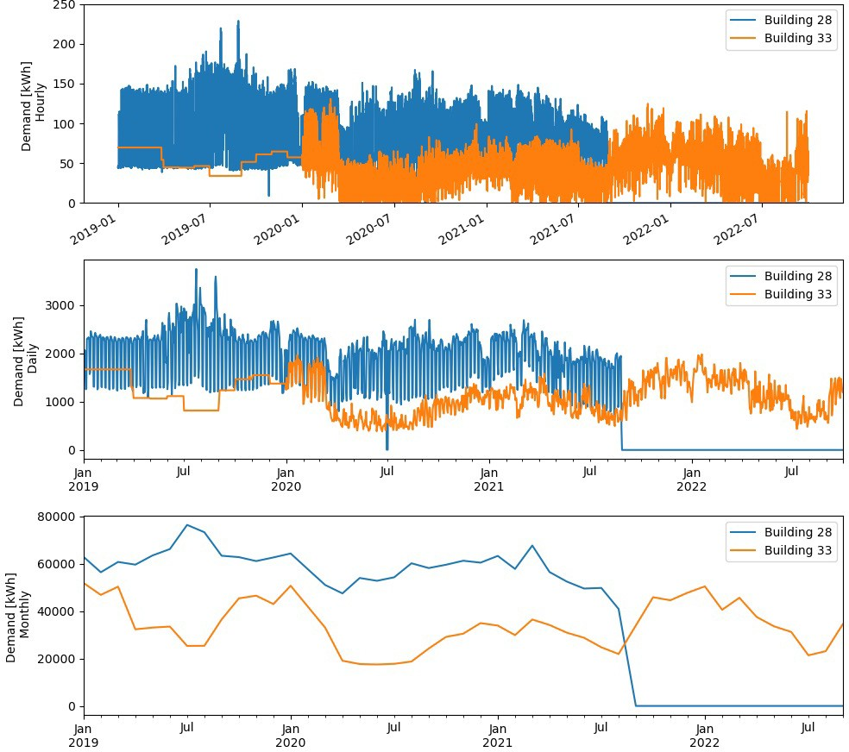
Downsampling
When gathering frequency does not match the intended application
Choice of frequency: hourly, daily, monthly, etc.
Choice of down sampling method
Mean: e.g., operating temperature, pressure
Sum: e.g., energy demand

Slide 34
Outliers
Removing unexpected outliers to ensure they do not influence the intended application:
expected range of values (if available)
Z-scores: need to pick a reasonable value

Slide 35
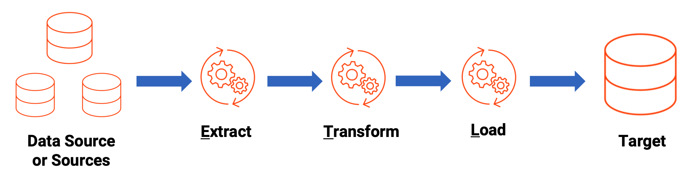
Integration
What
When the data preprocessing is finished, it can finally be integrated. The data can be pushed to the message broker, which will in turn store the data in the database.
Conditions and requirements
The tools like the message broker, and database need to be in place. Furthermore, the previously mentioned preprocessing needs to be performed on the data to have a proper Extract Transform and Load (ETL) pipeline.
Who needs to do it?
Data engineer
Smart buildings need to rely on a well-defined system architecture and Application Programming Interfaces (APIs) that enable both the integration of diverse systems and datasets and the orchestration of various services
Each individual building is unique, so developing a system architecture for each is impossible
Chamari et al. (2023) present a generic reference architecture focusing on data integration and system integration

Slide 36
Build application logic
Integrate
Define
data & system requirements
Define data gap
Determine plan to fill the data gap
Design integration architecture; understand sources
Data strategy implementation
Select integration tools and platforms
Pre-processing: Develop, test and deploy solution
Build application logic
Goals achieved?
No
Yes
End
Notes:
What does this step mean?
Finally, you can go ahead with building an intelligent building with AI, MPC, 4S3F fault detection methods, Bayesian networks, whatever can be dreamed up to optimize the assets performance.
Who needs to do it?
Data scientists

Slide 37
This Roadmap is a part of the Brains for Buildings (B4B) project. This is a multi-year, multi-stakeholder project that aims to develop smart building methods to enhance operations in buildings by reducing energy consumption, increasing energy flexibility, increasing occupant comfort, and improving installation maintenance costs. This will be achieved by developing faster and more efficient Machine Learning and Artificial Intelligence models and algorithms. The project is geared towards existing utility buildings, such as commercial and institutional buildings.
The Brains4Buildings is sponsored by the Dutch grant program for Mission-Driven Research, Development and Innovation (MOOI). This program was established by the Dutch Ministry of Economic Affairs and Climate Change and the Ministry of the Interior and Kingdom Relations and executed by RVO Netherlands Enterprise Agency.

