Slide 1
B4B Webinar 16 March Experiences with user feedback in a living lab environment
Sander van der Harst & Frans Joosstens

Slide 2
Introduction

Slide 3
Why feedback?
Part of WP 3
To determine the difference in measured comfort (sensordata) and the experienced comfort by building users
Use these insights to optimize comfort
These insights can lead to more efficient management of building

Slide 4
Control energy demand of Buildings
Part of WP 2
Being able to control the energy demand of buildings based on feedback of the users. Within what thermal comfort bandwidth can we operate in each building?
Being able to determine the so called 'buffer zone' of a building
Control buildings based on the energy market

Slide 5
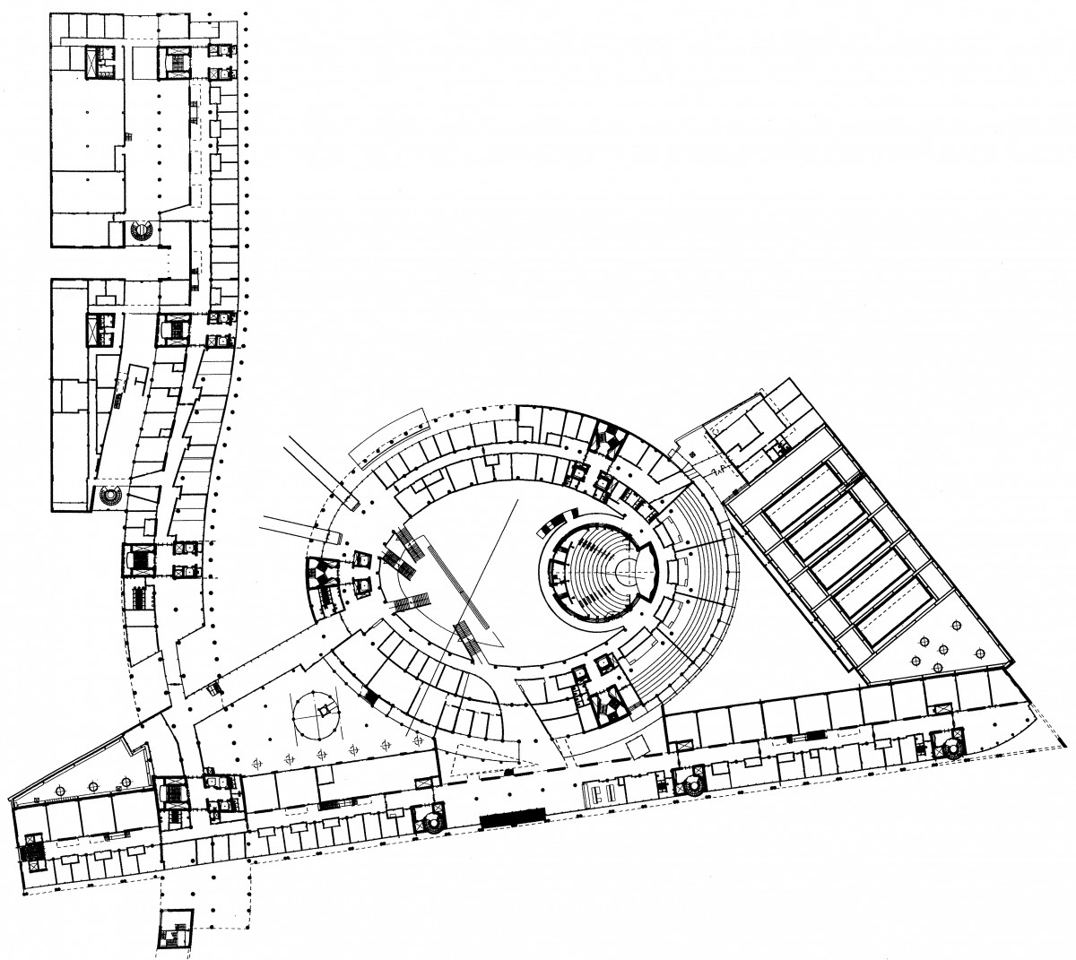
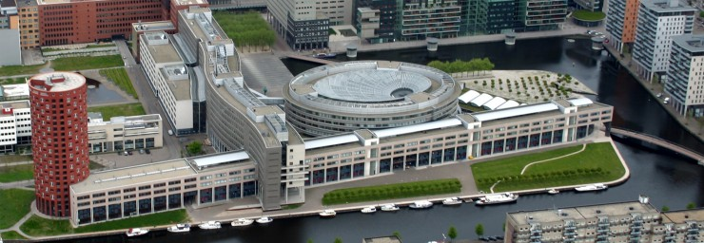
Living Lab of The Hague University of Applied Sciences

Slide 6
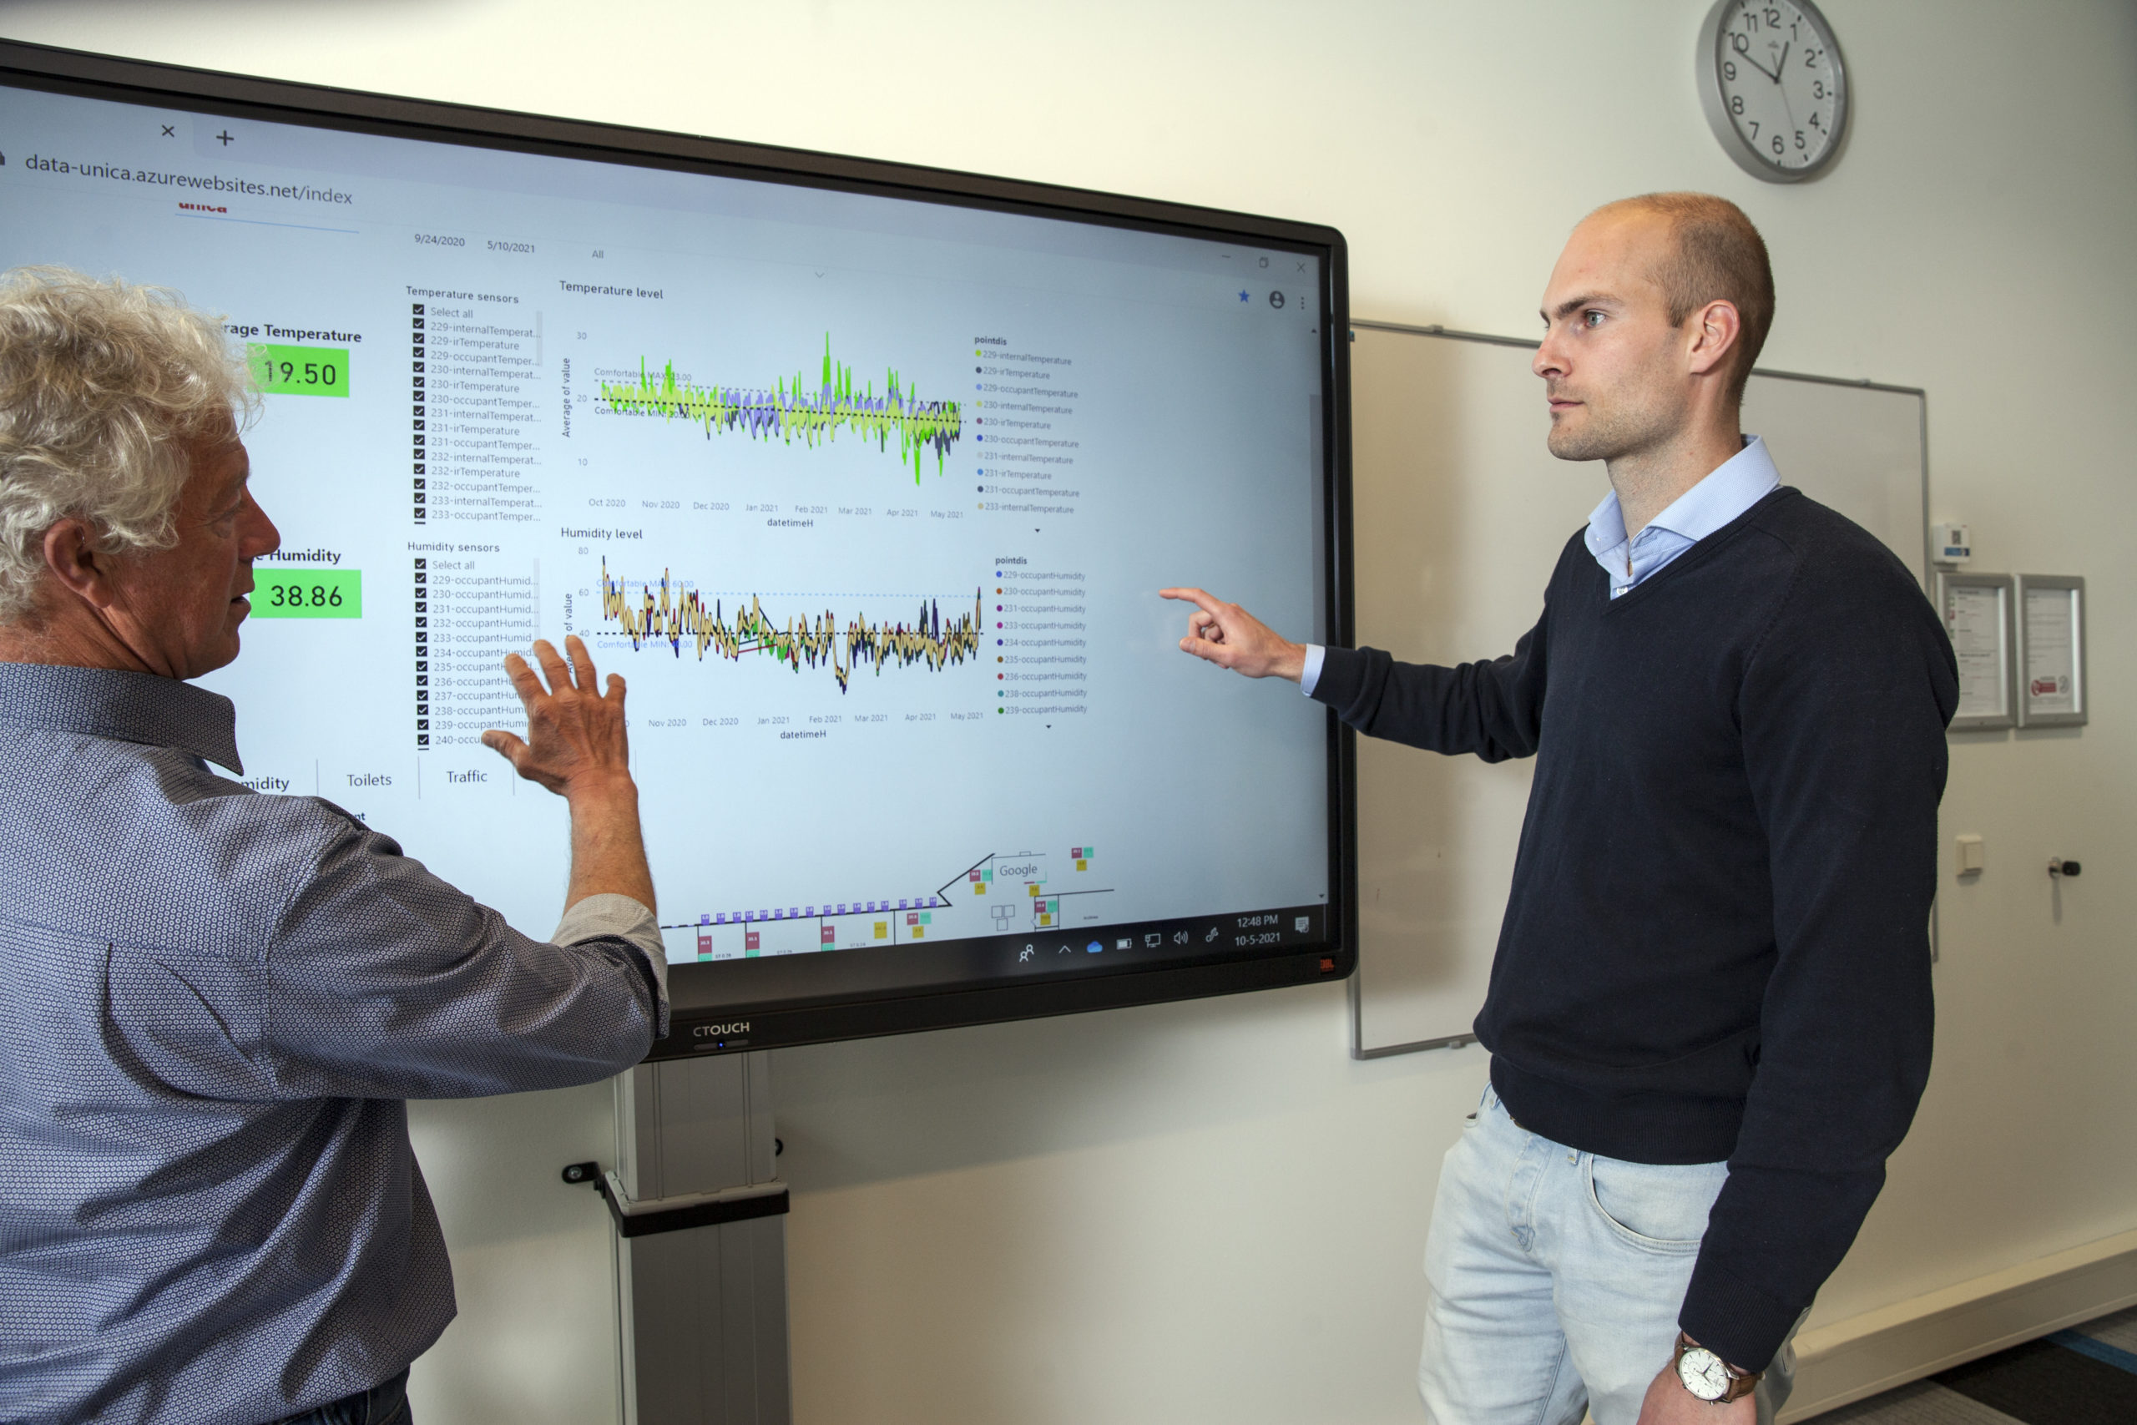
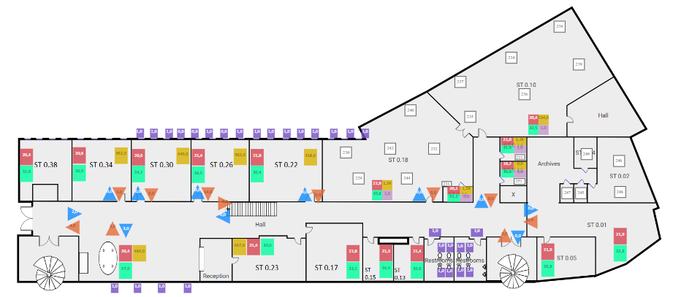
Data insights of the Living Lab

Slide 7
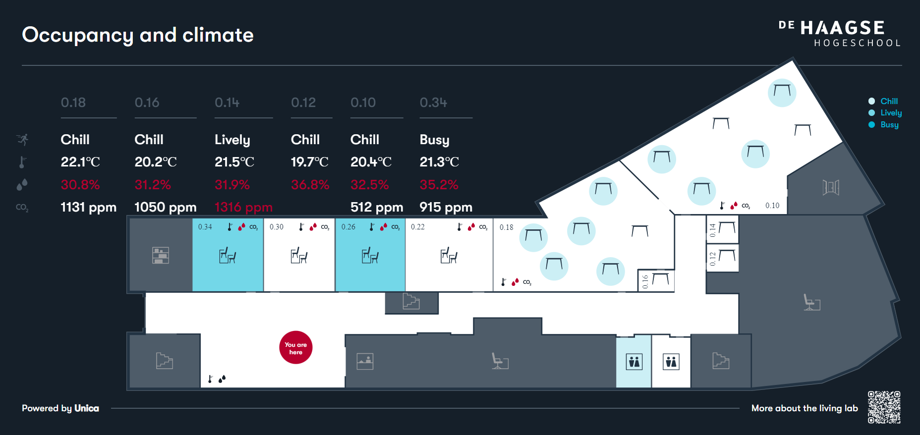
Narrowcasting at entrance

Slide 8
How to obtain user feedback?
We used 4 different methods to collect feedback from the end users.
Vote boxes
QR codes (including webapp)
Dedicated App
(Annual) survey

Slide 9
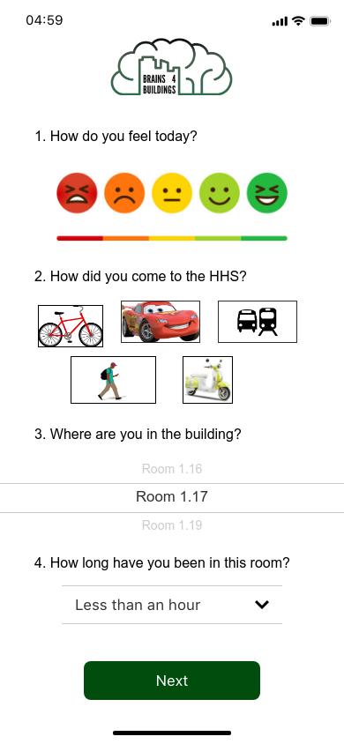
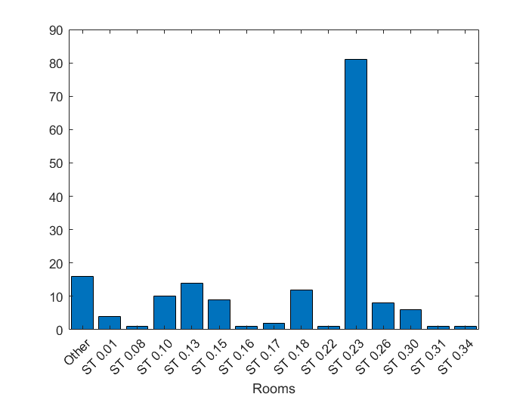
Results of the dedicated app

Slide 10
Results of the dedicated app
Feedback vs sensorvalue analysis of ST.0.23 – 81 responses
The average temperature is 21,51 if it is indicated that it is too warm(7 times).
The average temperature is 20,58 if it is indicated that it is too cold (20 times).
When people indicate too cold, it has often been colder before, so people have cooled down while the building was still warming up

Slide 11
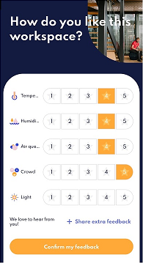
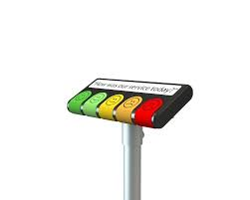
Other ways to obtain user feedback

Slide 12
Findings on different ways of feedback
Vote boxes*:
Generate a much higher number of comfort feedback than QR-codes or a yearly questionnaire. This suggests that using vote boxes is an attractive way to deliver self-triggered comfort feedback.
More extremes responses on the comfort scale were given compared to other feedback methods
QR codes*:
Generate a low number of comfort feedback
Quality of feedback is good, and can be used by everyone
App
Generate a low number of comfort feedback
Will only be used by employees who visit the rooms multiple times
Jaarlijkse enquête
Often a low response
Good insight into overall experience, but no insight into specific moments (which is needed to determine a buffer zone)
*Piet Jacobs et al. (2023), User centric assessment of comfort and health in offices – an explorative field study

Slide 13
Learnings
Each method has its own advantages and disadvantages
Performed methods are suitable for gaining more insights in a research situation but are not suitable in a normal situation.

Slide 14
Discussion
An alternative is to obtain data from the use of thermostats in a building. We would like to get more experience with this.
Next question
How can we retrieve data from users in a normal environment?

